Slide 1

Mentors and Advocates for Non-Traditional Engineering Students
Presentation for ENGR 111/112
Notes:
10 minutes. Be brief!!!

Slide 2
Has this ever happened?
First meeting – No apparent problems.
Second meeting – Students discuss ideas, Student A has ideas but the group isn’t listening.
Third meeting – Student A is sidelined.
Fourth meeting – Student A isn’t invited to the meeting.
Notes:
Group is formed, an assignment is given. This project is due in several weeks, so the group will meet several times.
In the first meeting, the group selects a topic/project and plans to discuss specific methods and ideas at the next meeting.
In the second meeting, each member has different ideas. Student A has ideas similar to other students, but other group members ignore their opinions.
In the third meeting, Student A is ignored. None of their feedback or ideas are considered.
What do you think was the cause for this exclusion? What are some good reasons for excluding a team member?
In the fourth meeting, Student A isn’t invited to the meeting.
Has this ever happened to you or someone you know?
By the way, this has happened SEVERAL times (even in the last year) at TAMU.
GREG

Slide 3
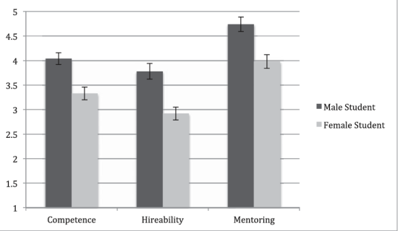
Implicit Bias
2013 Yale Study (Corinne Moss-Racussin et al.)
Identical (fictitious) resumes graded by male and female researchers and faculty
50% John, 50% Jennifer
50% John, 50% Juan
Notes:
Everybody has implicit bias, even if they think they don’t. This doesn’t mean we are all sexist, but these biases do have consequences.
Here’s a study.
What do you think?
How are you feeling?
Is this fair?
GABRIEL

Slide 4
Implicit Bias
Some “real-world” examples of implicit bias:
“Women aren’t as technical as men.”
“Women aren’t as good at math as men.”
“Women don’t belong in engineering.”
Challenge:
How much implicit bias do you have?
https://implicit.harvard.edu/implicit/takeatest.html
Notes:
Some “real-world” examples . . . GABRIEL
Challenge: . . . GREG

Slide 5
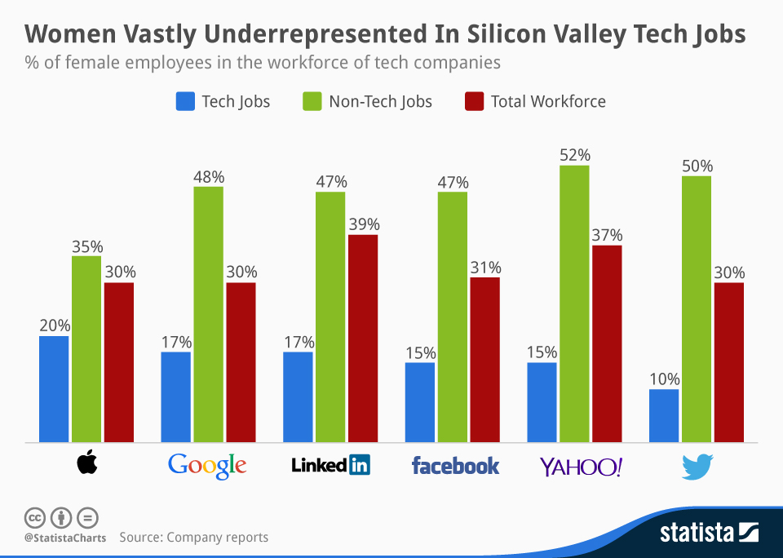
National Statistics
In undergraduate engineering programs, 19.9% are women. (Engineering by the Numbers, Brian L. Yoder, 2015)
Of currently practicing engineers, 11% are women. (STEMming the Tide, Fouad and Singh, 2011)
Notes:
Ignore the red bar (it’s just the average of the blue and red).
Currently at TAMU, 21.9% of total students are women (3,266 women students).
The goal is to have 25,000 students by 2025, and 36% (9,000) should be women.
We are not sharing this to discourage anyone. This information is to show what the current culture is, but we can change the culture, starting with us.
GREG

Slide 6
How can you be an advocate?
Guidelines:
Listen to women and their stories
Seek to understand
Respect and never invalidate personal experiences
Notice bias, take action!
Post
Tag @WE_TAMU, #WEincludeTAMU
Privately
Discuss the possible consequences of bias
Publicly
Speak out about bias
Be a visible advocate in the College of Engineering
tx.ag/weprogram
Notes:
Women are present as classmates, faculty, staff, students, cashiers, joggers,
Process:
Internally – reflect on the situation.
Externally – speak with others about what happened.
Recognize bias:
Ignoring or interrupting women, discounting their contributions, etc.
GABRIEL

Slide 7
Engineering 112 – Spring 2017
First meeting – No apparent problems.
Second meeting – Students discuss ideas, Student A has ideas but the group isn’t listening.
Third meeting – Student A is sidelined.
Fourth meeting – Student A isn’t invited to the meeting, and Student B is conflicted.
Fifth meeting – Student A is feeling isolated. What can Student B do to resolve this situation?
Notes:
In the fourth meeting, Student A isn’t invited to the meeting, but now you (Student B) notices! (Student B can be a woman, too!)
When do you think this internal conflict for Student B starts? When were they uncomfortable?
GREG

Slide 8

Join MAGNETS!
For more information about Women in Engineering, email WEoutreach@tamu.edu.
For more information about joining MAGNETS, email gregbk@gmail.com.
Notes:
Fill out our survey!

